Slide 1
Chapter 26 Section 2
An Expanding Role
For Government

Slide 2
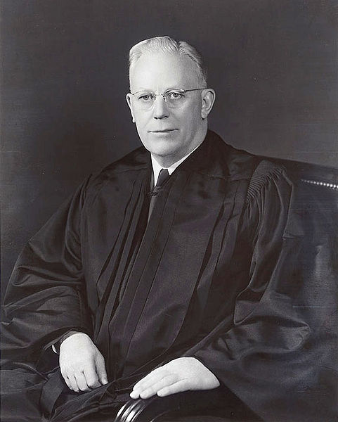
The Warren Court
1953 – Earl Warren was appointed chief justice of the Supreme Court by Eisenhower
1954 – Brown v. Board of Education of Topeka ruling
1966 – Miranda v. Arizona ruling made it law that police must advise arrested persons of their rights to remain silent and to have a lawyer. This is the result of Miranda being convicted because of a confession to police without representation
1969 – Tinker v. Des Moines School District expanded rights of students in schools and their rights of speech. This resulted when students protested the Vietnam War by wearing black arm bands and were suspended for doing so.
http://en.wikipedia.org/wiki/File:Earl_Warren.jpg

Slide 3
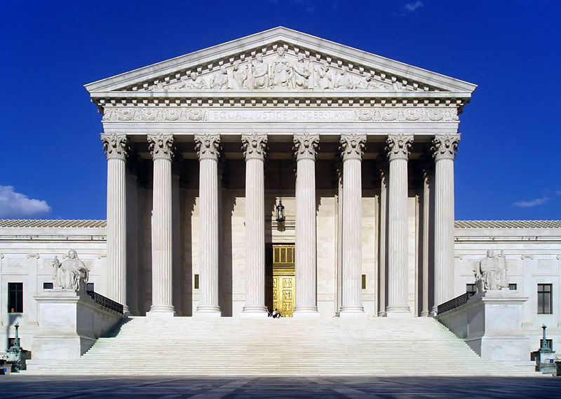
Judicial Activism
Warren was different from other chief justices because he believed that the Constitution should be interpreted flexibly
This meant that things should be looked at in the context of the times and the court began striking down previous laws that the justices thought were unfair
This is called “judicial activism”
Many critics thought the Warren Court was going too far and not respecting the law the way the framers of the Constitution intended
Critics also said this gave justices too much power!
http://en.wikipedia.org/wiki/File:USSupremeCourtWestFacade.JPG

Slide 4
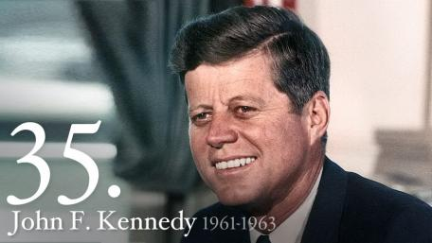
The Kennedy Presidency
J.F.K. became our youngest elected president by a narrow margin in 1960
Inaugural address (Part 1)
Inaugural address (Part 2)
Kennedy tried to deal with the problems of poverty that affected 20% of the nation, but Congress won out for the most part
Kennedy wanted to push forward with civil rights legislation, but time ran out
Kennedy’s most lasting accomplishments were the space program and the Peace Corps
http://www.whitehouse.gov/about/presidents/johnfkennedy

Slide 5
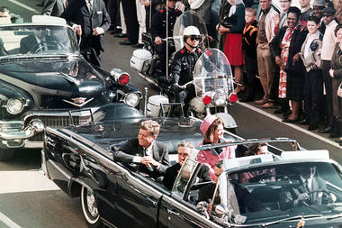
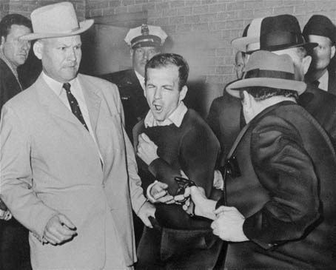
Assassination
November 22, 1963 in Dallas Texas President Kennedy was shot and killed
Discovery Education Video (Web)
Within hours the Dallas police had apprehended Lee Harvey Oswald
Two days later the nation witnesses Lee Harvey Oswald being shot and killed by Jack Ruby while being transferred to another jail live on television
Several months later the Warren Commission ruled that Oswald acted alone and without any help
Many people to this day do not believe this, and subscribe to some form of conspiracy theory.
http://www.csmonitor.com/USA/DC-Decoder/2013/1122/John-F.-Kennedy-assassination-three-key-mysteries-video
http://voices.washingtonpost.com/blog-post/2010/11/kennedy_assassination_where_we.html

Slide 6
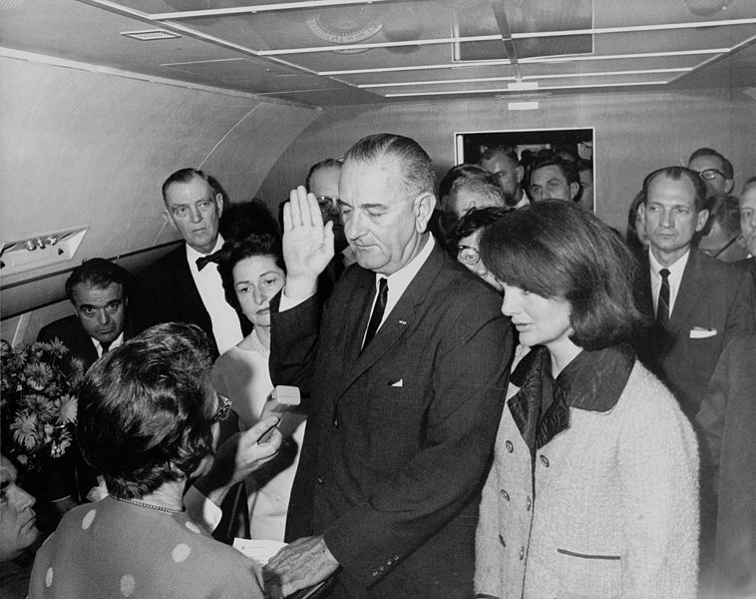
President Johnson
Lyndon B. Johnson becomes president the day J.F.K. is killed on board Air Force One
1964 he runs for president and wins by a landslide margin
So who is Johnson?
http://en.wikipedia.org/wiki/File:Lyndon_B._Johnson_taking_the_oath_of_office,_November_1963.jpg

Slide 7
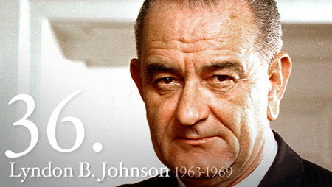
L.B.J.
Grew up poor in Texas
Teacher of poor Mexican Americans in Texas
From this became convinced that the government needed to do something to help the poor and oppressed
Big supporter of F.D.R. and his New Deal policies
Rose in politics from a Representative during the Depression, to Senator in 1948, and then Vice-President in 1961
http://www.whitehouse.gov/about/presidents/lyndonbjohnson

Slide 8
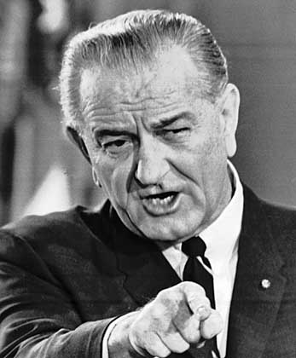
Johnson’s Great Society
Johnson began by pushing more laws through Congress than anyone since the New Deal
First tried to finish what Kennedy had started with a civil rights law
Next started his “War on Poverty”
Head Start – preschool for needy
Welfare system – cash payments to the poor
HUD (Department of Housing and Urban Development) – building of middle and low income housing
Medicare – people 65 and older aid for medical bills
Medicaid – assisted people of all ages with money who were not covered by Medicare
http://academics.wellesley.edu/Polisci/wj/Vietimages/Audio/lbj-paxton.html

Slide 9
Lasting Effect’s?
Great Society expanded the role of the government
Critics felt it was not the responsibility of the federal government to provide for people on such a large scale
Most of the programs were costing the taxpayers too much money and poorly run so they were not working as intended

